Slide 1

“ E-Commerce website”
Task - 1

Slide 2

YourꢀProjectꢀName
▪
YourꢀProjectꢀIntroduction
LMS Username | Name | Batch
au310520104018 | V. Ashwin Raj | 06
au310520104020 | S.Bagavathi | 06
LMS Username
Name
Batch

Slide 3
INTRODUCTION
An e-commerce website is a digital marketplace revolutionizing retail. It empowers users to explore an extensive array of products and services, facilitating transactions and interactions online. Through intuitive interfaces and secure payment gateways, these platforms offer convenience and accessibility, accommodating diverse consumer needs. They often incorporate features like personalized recommendations and user reviews, enhancing the shopping experience. Catering to global audiences, e-commerce sites redefine traditional commerce by enabling seamless transactions and connections between buyers and sellers worldwide.

Slide 4
Scope of Development Project
The project scope entails developing an intuitive e-commerce platform, encompassing product management, user accounts, and secure checkout features. It involves robust security measures, mobile responsiveness, and customer support channels for inquiries. Marketing tools and analytics for insights into user behavior and sales performance are integral. Efficient logistics management and scalability planning ensure smooth operations and future growth readiness within the project scope.

Slide 5
Definitions, Acronyms and Abbreviations
HTML -> Hyper Text Markup Language
CSS-> Cascading Style Sheet
BOOTSTRAP-> Strategically Transforming Resources and Accelerating Progress
REACT JS-> Responsive Engineering: Adaptable Component Technology, JavaScript's Strengths

Slide 6
References
Books
○ Airey, D., 2010. Logo Design Love: A Guide to Creating Iconic Brand Identities
○ Berkeley, CA: New Riders
Websites
○ http://www.smashingmagazine.com/2013/06/workflow-design-develop-modern-e commerce-website/
○ http://business.tutsplus.com/articles/the-secret-to-getting-a-lot-of-web-design-work--fsw-390

Slide 7
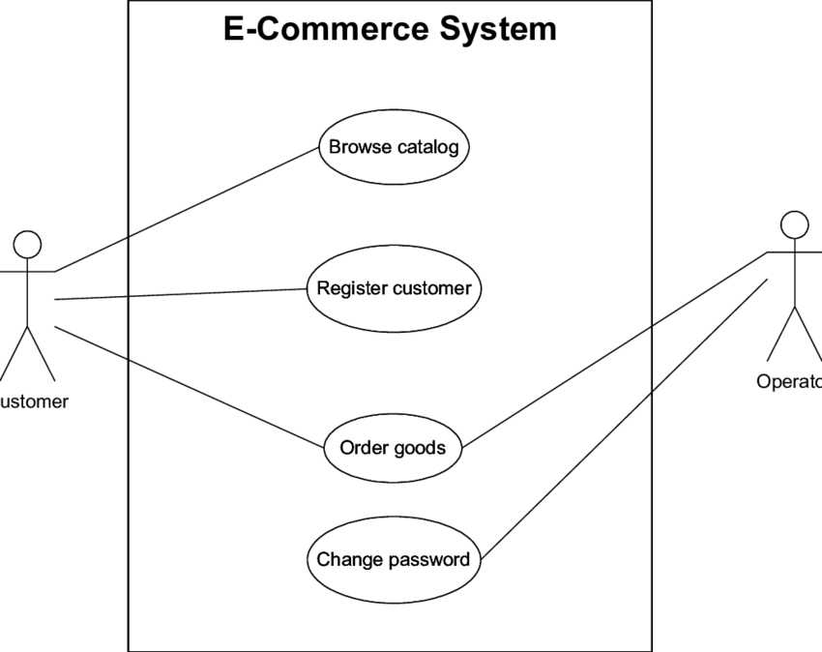
Overall description
Product perspective
Use case diagram of e commerce website

Slide 8
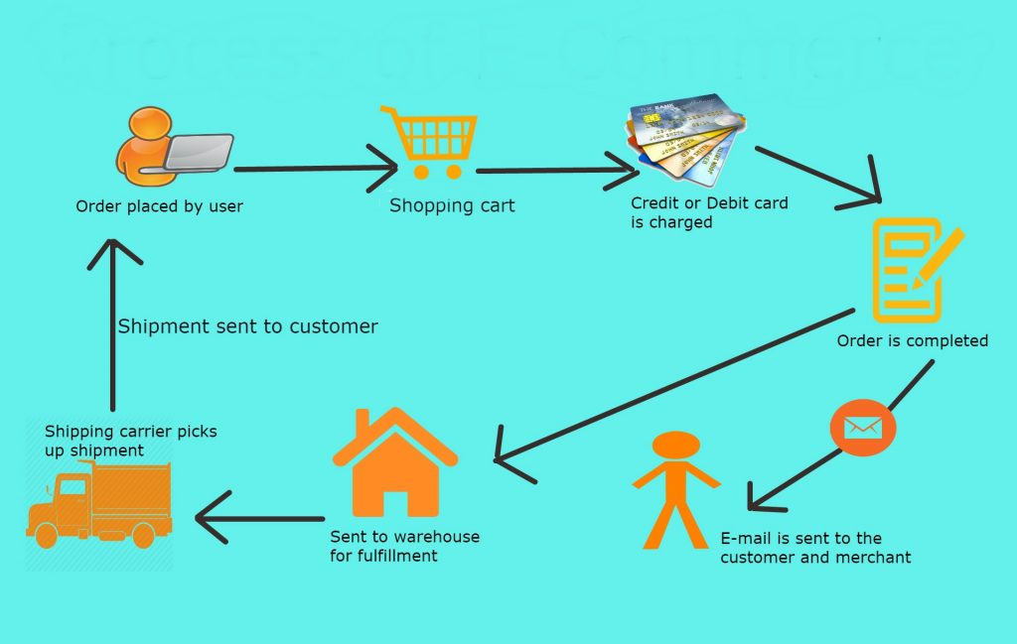
Product function
Entity Relationship Diagram of E-commerce Management System

Slide 9
Class diagram
A class is an abstract, user-defined description of a type of data. It identifies the attributes of the
data and the operations that can be performed on instances (i.e. objects) of the data. A class of
data has a name, a set of attributes that describes its characteristics, and a set of operations that
can be performed on the objects of that class. The classes’ structure and their relationships to
each other frozen in time represent the static model. In this project there are certain main classes which are related to other classes required for their working. There are different kinds of
relationships between the classes as shown in the diagram like normal association, aggregation,
and generalization. The relationships are depicted using a role name and multiplicities. Here
‘user’, ‘project’ , ‘Contact form’ and ‘about me’ are the most important classes which are related to other classes.

Slide 10
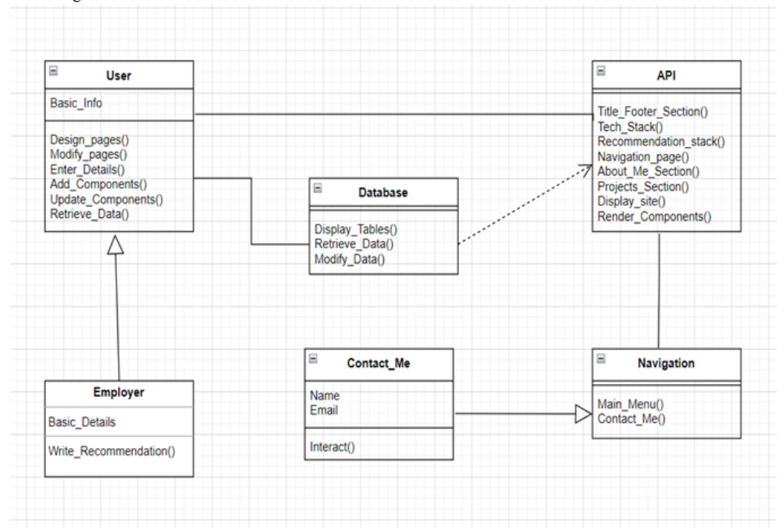

Slide 11

Submission Github
https://github.com/suryaks2602/NM-DSCET-7.git

Slide 12


